Slide 1

Team Name : CR007
Team Leader Name : Aditya Kumar
Problem Statement : Gamifying Financial Literacy for Bharat – Incentive Learning through Pay

Slide 2

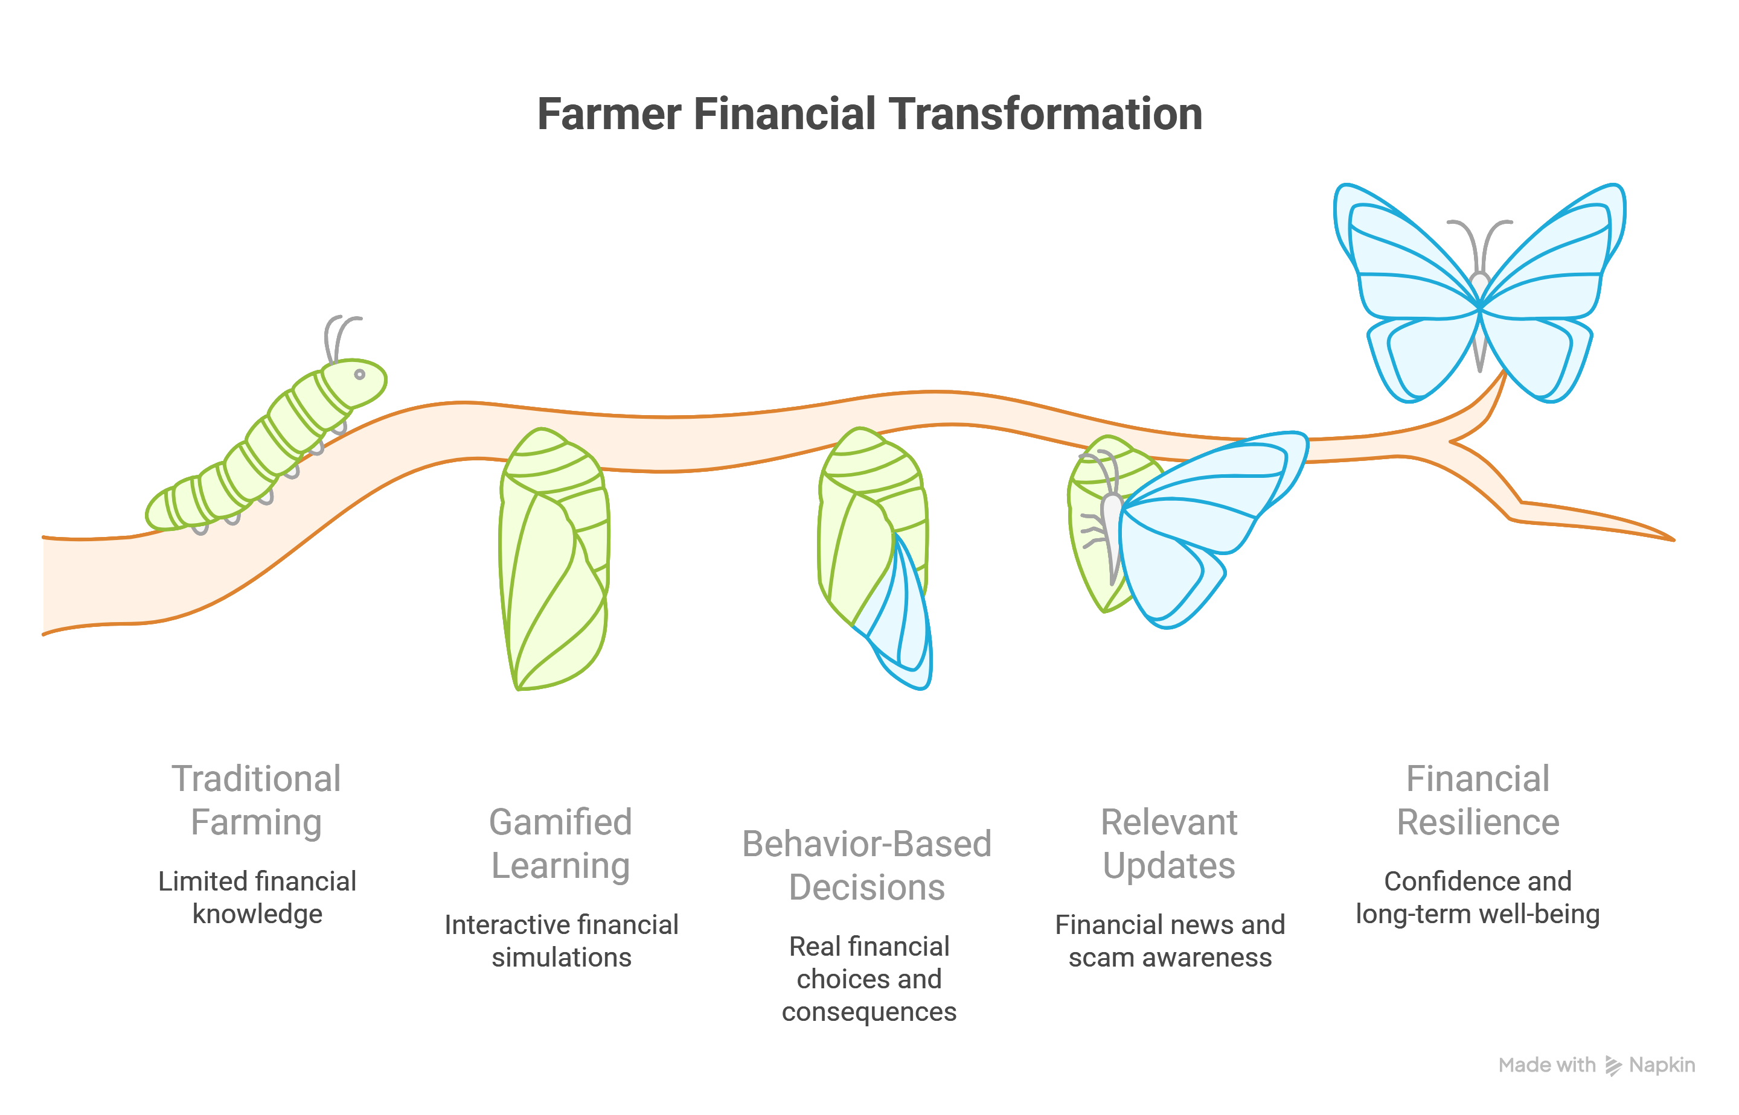
Brief about the Idea:
> KISHAN SAATHI is a multilingual, hyper-local, gamified financial life simulator for farmers. It simulates a full agricultural year, where farmers must manage seasonal harvest income to cover year-round expenses, savings, investments, and risk protection.
> The platform focuses on behavior-based learning by letting farmers make real financial decisions and experience their consequences. It also delivers relevant financial updates, government schemes, and scam awareness through voice and SMS, supported by interactive simulations.
> Designed to be low-bandwidth, offline-friendly, and voice-first, KISHAN SAATHI bridges the gap between traditional farming and modern digital finance, helping farmers build financial resilience, confidence, and long-term well-being.

Slide 3
Your solution should be able to explain the following:
How different is it from any of the other existing ideas?
Unlike generic finance apps, KISHAN SAATHI is context aware and built around agricultural seasons, simulating how farmers actually earn, spend, and save. It is voice-first, multilingual, and SMS-based, enabling behavior-driven learning through real-life financial decisions not theory
How will it be able to solve the problem?
KISHAN SAATHI solves the problem by letting farmers practice real financial decisions : budgeting, saving, credit, insurance, and fraud avoidance through seasonal simulations that mirror their actual income cycles.
By using voice, local language, and SMS, it converts awareness into behavior, building financial resilience and confidence in everyday life.
USP of the proposed solution
Seasonal Cash flow Engine : Season-based financial life simulation tailored to farmers’ real income cycles, delivered through a voice-first, multilingual, low-bandwidth platform.
It focuses on behavior change through real-life decisions and consequences, not theoretical financial education.

Slide 4
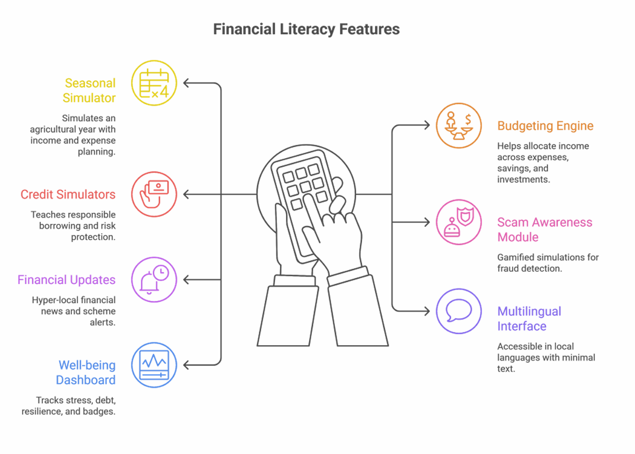
List of features offered by the solution :
Seasonal Financial Life Simulator : Simulates a full agricultural year with harvest-based income and year-round expense planning.
Budgeting & Savings Allocation Engine : Helps farmers allocate income across expenses, savings, investments, and emergencies.
Credit, Loan & Insurance Simulators : Teaches responsible borrowing, interest impact, and risk protection through real-life scenarios.
Digital Finance & Scam Awareness Module : Gamified UPI, OTP, and fraud detection simulations via voice/SMS.
Real-Time Financial Updates : Hyper-local financial news and government scheme alerts through SMS and voice.
Voice-First, Multilingual Interface : Accessible in local languages with minimal text and offline-friendly design.
Financial Well-being Dashboard : Tracks stress level, debt load, resilience score, points, and earned badges.

Slide 5
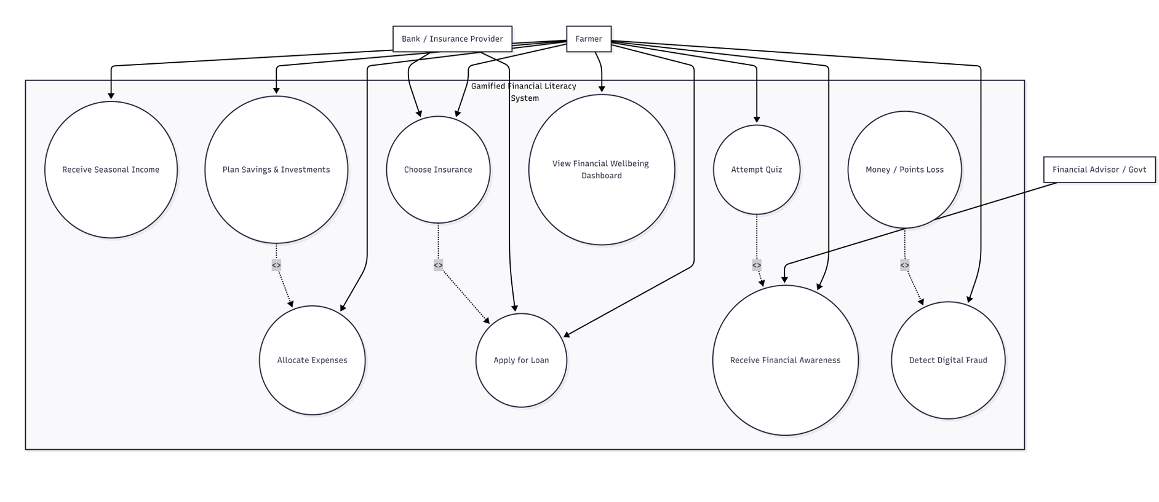
Process flow diagram or Use-case diagram:

Slide 6
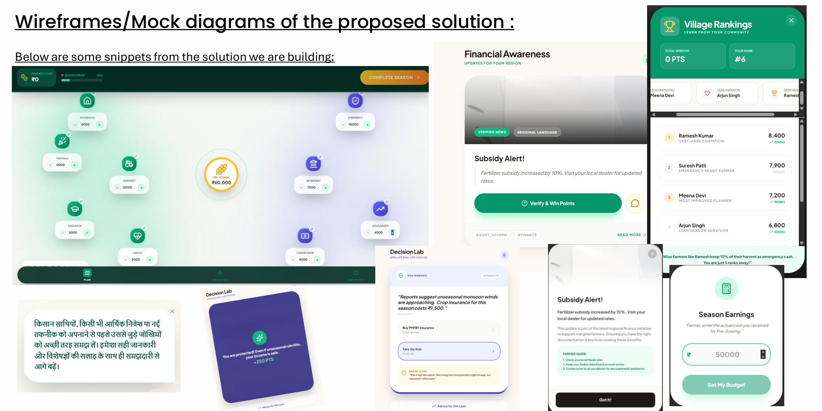

Slide 7
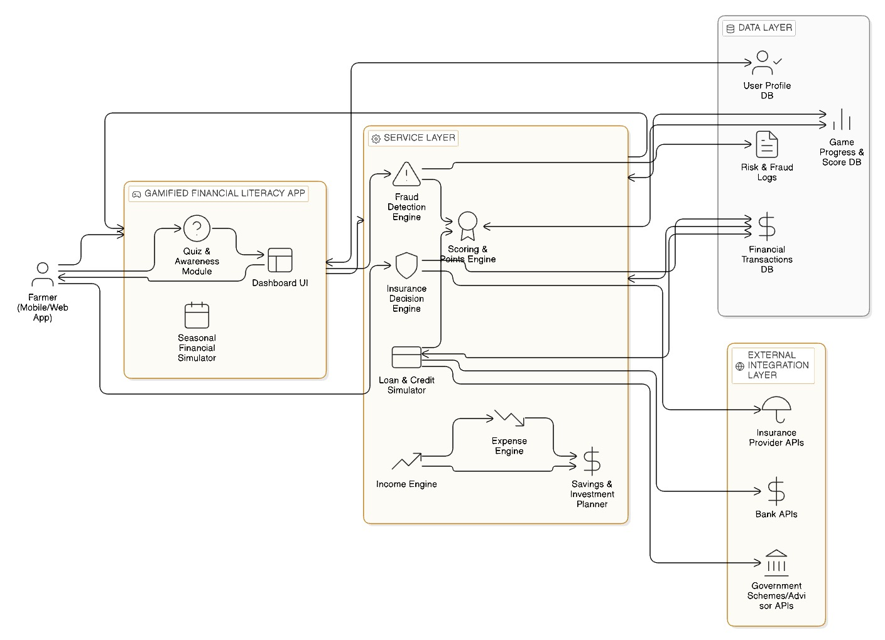
Architecture diagram of the proposed solution:

Slide 8
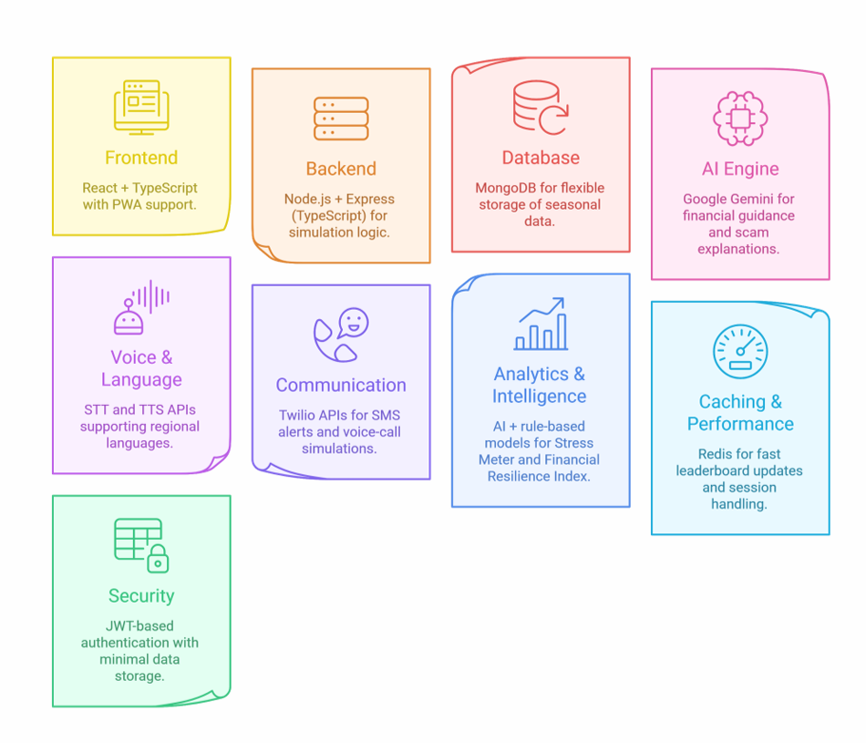
Technologies to be used in the solution :
Frontend: React + TypeScript with PWA support for offline-first, low-bandwidth, web-based dashboards
Backend: Node.js + Express (TypeScript) for seasonal simulation logic, scoring engine, and leaderboard management
Database: MongoDB for flexible storage of seasonal data, user decisions, and behaviour history
AI Engine: Google Gemini for contextual financial guidance, decision feedback, and scam explanations in simple language
Voice & Language: Speech-to-Text (STT) and Text-to-Speech (TTS) APIs supporting regional languages for voice-first interaction
Communication: Twilio APIs for SMS alerts and voice-call based scam simulations (works on feature phones)
Analytics & Intelligence: AI + rule-based models to compute Stress Meter and Financial Resilience Index from user decision patterns
Caching & Performance : Redis for fast leaderboard updates and session handling
Security: JWT-based authentication with minimal data storage and privacy-first design

Slide 9
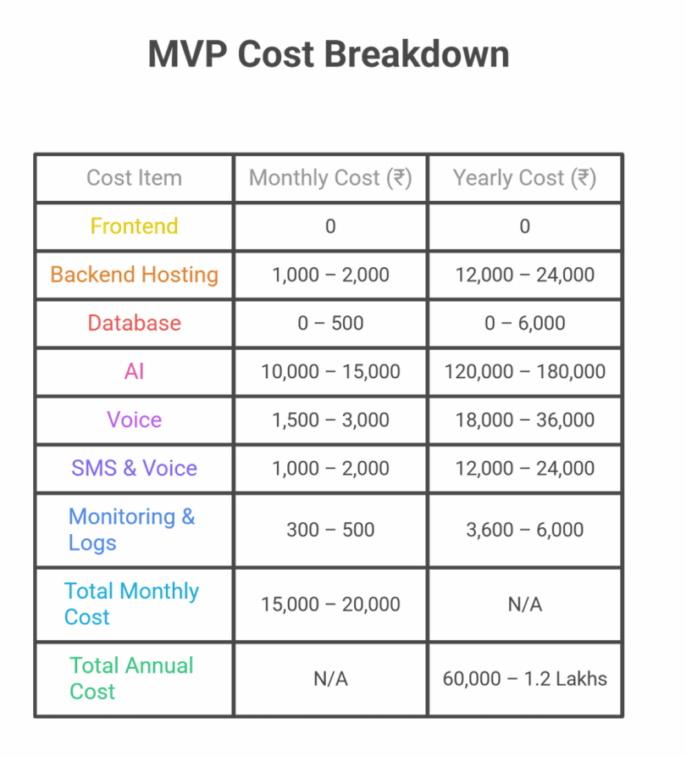
Estimated implementation cost (optional):
Below estimation is for 100-200 users load :
Frontend (React + TypeScript + PWA): ₹0 (open-source, self-developed)
Backend Hosting (Node.js + Express): ₹1,000 –₹2,000
Database (MongoDB Atlas –shared tier): ₹0 –₹500
AI (Google Gemini API): ₹10,000 –₹15,000
Voice (STT + TTS – regional languages): ₹1,500 –₹3,000
SMS & Voice (Twilio): ₹1,000 – ₹2,000
Monitoring & Logs: ₹300 –₹500
Total Monthly Cost (MVP): ₹15,000 –₹20,000
Yearly Cost (Same Scale, Optimized Usage)
Total Annual Cost:₹60,000 –₹1.2 Lakhs

Slide 10
Add as per the requirements for the hackathon:
Financial Literacy Simulation: Process Flow (Hackathon Requirements)
• Onboarding: Farmer selects local language (voice-supported) and inputs basic crop type and seasonal cycle.
• Harvest Phase: Virtual harvest income is credited; user allocates funds across living expenses, seeds, savings, insurance, and retirement.
• Simulation Phase: Realistic random events (scam calls, medical needs, weather losses, loan offers) force real-time financial decisions with consequences.
• Verification & Reinforcement: Short daily SMS/voice-based micro-quizzes and alerts reinforce correct financial behavior.
• Evaluation: End-of-season assessment using a Financial Resilience Index, stress score, and leaderboard ranking to motivate sustained learning.

Slide 11


